Slide 1
LLM for Business Content Creation
Team:
Dinar Galimov, Harbin Institute of Technology
Abdulrahman Nabil Abdo Al-sameai, Yangzhou University
Al-haimady Osama Yahya Mohammed Ahmed, Yangzhou University,
Umar Muhammad Mustapha Kumshe, Hohai University
Curator(s) name: Dmitry Bazyukin, Dmitry Akulichev,
Alexey Chernyshov, Andrey Kostornoy, Artem Kopin

Slide 2

Problem Statement & plan
Defining the Challenge: The complexity of central bank language and its impact on public trust.
Our Plan: To use a lightweight, fine-tuned LLM to simplify these communications without losing meaning.
Methodology
Our Technical Approach: The process of fine-tuning the Vikhr-Llama model using Unsupervised Style Transfer.
Overcoming Hurdles: How we navigated hardware limitations, dependency issues, and data integrity problems.
Result & Recommendation
Our Findings: Presenting clear, "before-and-after" examples of simplified text and the measurable improvement in key metrics.
Next Steps: Proposing actionable recommendations for integration and future research.
Problem Statement & plan
Methodology
Result &
Recommendation

Slide 3

The Challenge & Our Solution
Enhancing Central Bank Communication with AI
The Problem: Official communications from central banks are often filled with technical jargon and complex language, making them inaccessible to the public.
Why It's Important: This lack of clarity can undermine public trust and weaken the impact of monetary policy.
Our Solution: We use a compact and efficient Large Language Model (LLM) to simplify complex regulatory language into clear, accessible Russian.
Model: Vikhr-Llama-3.2-1B-instruct, a lightweight model ideal for real-world deployment.

Slide 4
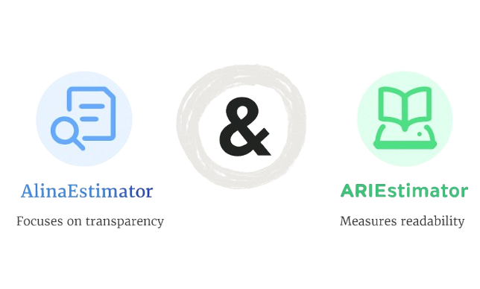
The Challenge & Our Solution
Enhancing Central Bank Communication with AI
Our Process: We transform dense text into clear communication through a rigorous funnel:
Simplify with LLM
Evaluate Transparency (AlinaEstimator)
Evaluate Readability (ARIEstimator)
Expert Review

Slide 5
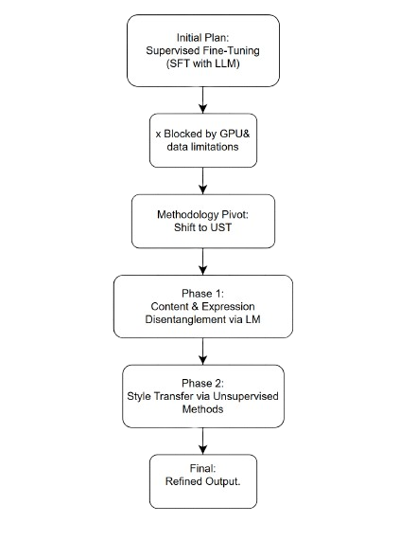
Methodology: From Roadblock to Breakthrough
How We Trained the Model
Initial Goal: Supervised Fine-Tuning (SFT)
The standard approach, SFT, requires a paired dataset of "complex" and "simple" texts to teach the model a direct transformation.
The Roadblock: The Synthetic Data Bottleneck
Creating the required paired dataset was infeasible due to resource and access restrictions in our development environment.

Slide 6
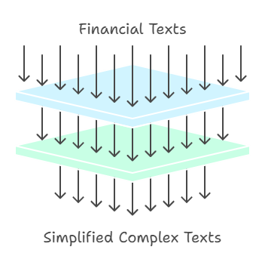
Methodology: From Roadblock to Breakthrough
The Pivot: Unsupervised Style Transfer (UST)
Faced with constraints, we adopted a more practical approach: Unsupervised Style Transfer.
Phase 1: Style-Tuning: We fine-tuned the model exclusively on a dataset of simple, clear financial texts. This imbued the model with a strong stylistic preference for clarity.
Phase 2: Prompt-Based Inference: We then used strong instructional prompts to guide the "style-tuned" model to rewrite complex texts in the simple style it had learned.
Overcoming Hurdles: This process required solving significant technical challenges related to hardware (NPU), outdated libraries, and data integrity.

Slide 7
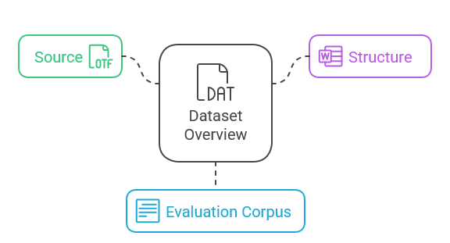
A Closer Look at the Datasets
Dataset Overview
Source: The input data consists of Russian-language financial texts from the Bank of Russia.
Structure: Each text entry includes a unique ID, pre-evaluated scores, the original text, and a word count.
Evaluation Corpus: The evaluation metrics were developed using a corpus of 10,000 Russian texts, which were classified into ten distinct readability levels.

Slide 8
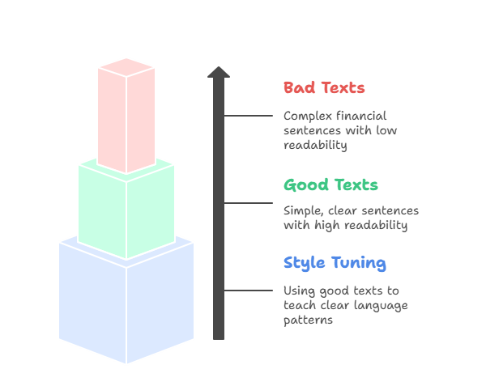
A Closer Look at the Datasets
Training Datasets for Fine-Tuning
Our methodology required separating the source data into two distinct, unpaired collections:
bad_texts.json: This collection contained complex financial sentences characterized by low readability scores.
good_texts.json: This collection consisted of simple, clear sentences with high readability scores.
Unsupervised Approach: Because the "bad" and "good" examples were not directly paired, a standard Supervised Fine-Tuning (SFT) was not possible. The
good_texts.json dataset was used exclusively in the "style-tuning" phase of our Unsupervised Style Transfer approach to teach the model the patterns of clear financial language.

Slide 9
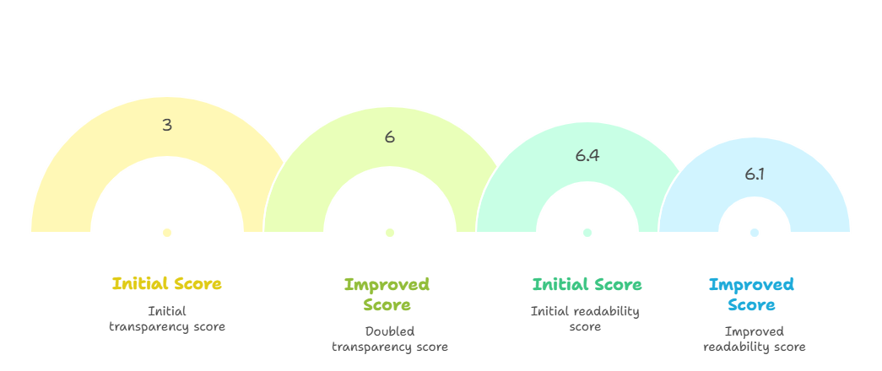
Results & Discussion
Measurable Success
Proven Success: Our Unsupervised Style Transfer method successfully simplified complex financial text while preserving all critical numerical data.
Example of a Successful Simplification:
The model deconstructed a dense sentence into multiple, more digestible parts.
All key data (770 billion rubles, -14%, -5%, +8%) was preserved accurately.
Quantifiable Improvement: The simplified text showed significant improvement in our core metrics.
Transparency (AlinaEstimator): The score doubled from 3 to 6, indicating much clearer communication.
Readability (ARIEstimator): The score decreased from 6.4 to 6.1, meaning the text is easier to understand.

Slide 10
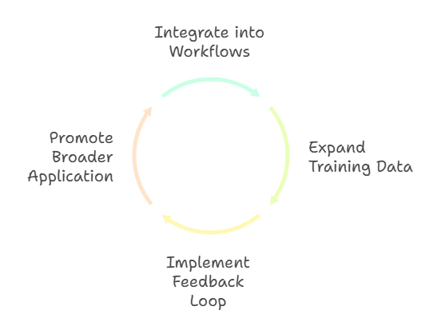
Recommendations
Actionable Recommendations
Integrate into Workflows: The Bank of Russia should consider integrating this model as an assistive tool to generate initial drafts of press releases and reports for human expert review.
Continuous Model Refinement: Improve the model by expanding the training dataset with a wider variety of historical documents and speech transcripts. A feedback loop using expert corrections should be implemented for ongoing fine-tuning.
Promote Broader Application: Other government agencies, both in Russia and internationally, could adapt this efficient and transferable methodology to improve their own communications.

Slide 11
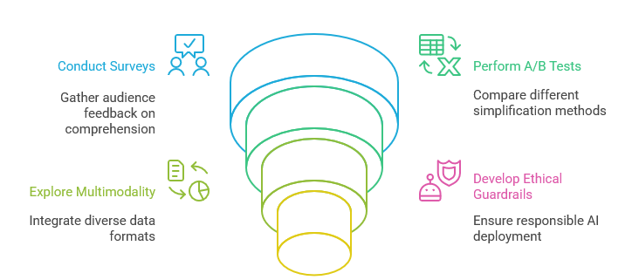
Future Research Directions
Quantitative Impact Assessment: Conduct surveys and A/B tests with diverse audiences to quantitatively measure the real-world impact of the simplified texts on public comprehension and trust.
Explore Multimodality: Future research should explore multimodal LLMs capable of interpreting and simplifying information from various formats like charts, graphs, and videos.
Develop Ethical Guardrails: Further research into explainability (XAI) is needed to help human overseers understand the model's choices, which builds trust and ensures responsible deployment.

Slide 12

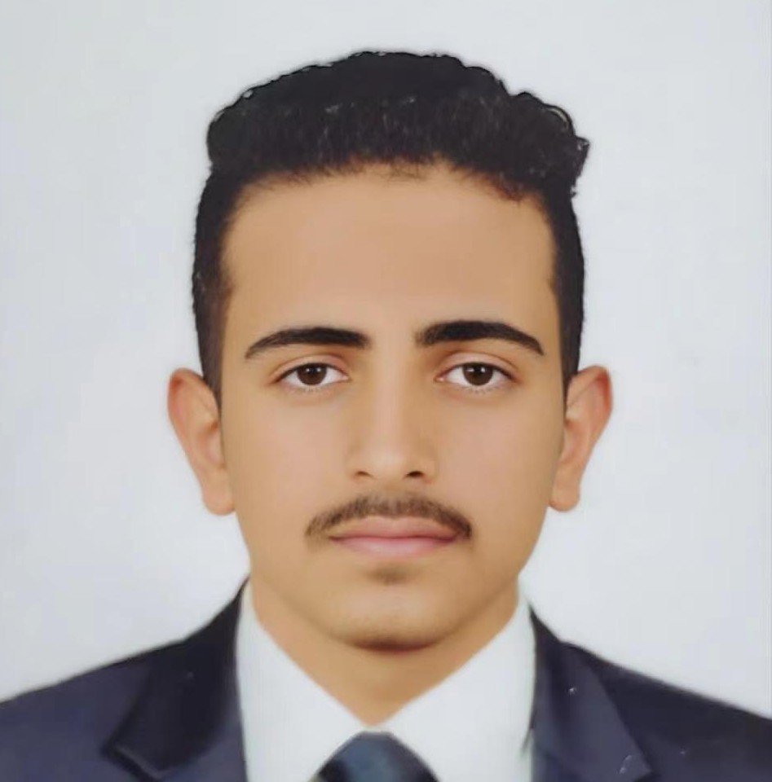

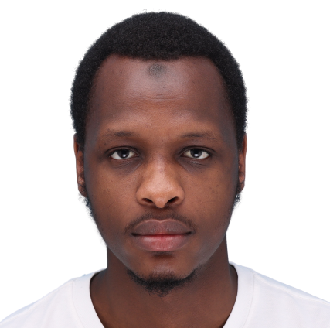
Dinar Galimov
Affiliation: Harbin Institute of Technology
Executed the testing phase, applying the AlinaEstimator and ARIEstimator metrics to measure the output quality.
Performed final evaluation on simplified text outputs & Led literature review
Abdulrahman Nabil Abdo Al-sameai
Affiliation:Yangzhou University
Managed complex/simple text dataset preparation
Configured training environment; resolved NPU & software issues
Al-haimady Osama Yahya Mohammed Ahmed
Affiliation:Yangzhou University
Fine-tuned Vikhr-Llama-3.2-1B-instruct using Unsupervised Style Transfer
Implemented style-tuning, prompt-based inference, and resolved data integrity issues
Umar Muhammad Mustapha Kumshe
Affiliation:Hohai University
Prepared final report, including limitations and future recommendations.
Guided pivot to Unsupervised Style Transfer due to project constraints.
1
2
3
4

Slide 13
Thank you !!

